Slide 1
The Pattern of Racing
Ruth Quinn

Slide 2
The Concept:
The Pattern forms the basis for selecting the future of the breed

Slide 3
“Why bother? Why try to remember which race is better than, or inferior to, another?
Because to improve the breed, to upgrade a broodmare band, to select a stallion, to understand a catalogue page, to evaluate a family – one must be able to recognize racing class.”
Kent Hollingsworth, Editor of The Blood-Horse,
January 1974

Slide 4
Establishment of the Pattern
Concept originated in Britain in the mid-1960s, where the recommendations from a specially-appointed committee would provide the rationale for the Pattern today:
“The Turf Authorities must ensure that a series of races over the right distances, and at the right time of the year, are available to test horses of all ages, and they must attempt to ensure that the horses remain in training long enough and race often enough to be tested properly for constitution and soundness.”
Implementation of a comprehensive system of races, centring round the traditional programme of the Classics and other important races which had evolved in Britain during the previous two centuries.

Slide 5
Creation of the European Pattern
At the end of the 1960s international racing within Europe was in a state of crisis.
French racing authorities were under strong pressure to restrict their races to horses trained in France.
Severe setback to international racing which had been developing steadily since end of WWII.
Solution to the crisis was the creation of the European Pattern race system in 1971.
Successful creation of the Pattern depended on application of internationally agreed judgements of quality.
Led to the division of all the races within the Pattern into three Groups: Group 1, Group 2, Group 3 .

Slide 6
Creation of the European Pattern Committee
Set up by Member Countries to regulate the European Pattern as a whole.
Given responsibility to prevent mutually damaging clashes in different countries at Group 1 and Group 2 level, and for sanctioning the introduction of new races or any major changes.
Control of the committee is exercised within the framework of detailed Terms of Reference and Ground Rules, ensuring good governance as well as consistent and strict quality control processes are in place.

Slide 7
Listed Races
What followed was mounting levels of investment in racing and breeding.
Development of a complex and vast international business.
Race programme, breeding industry and bloodstock markets are interdependent.
The Group race programme started to prove inadequate for identification of all racehorses of superior merit.
A fourth layer of quality below the Pattern gained increasing importance, namely ‘Listed races’.
Regulation of Listed races commenced in the mid-1980s.

Slide 8
The American Graded Stakes Committee
The American Graded Stakes Committee (AGSC) - founded by the Thoroughbred Owners and Breeders Association (TOBA) in 1973.
The AGSC evaluates and affirms the relative quality of races, identified as Grade 1, Grade 2, Grade 3 and Listed.
The grading of US races began, primarily at the request of European authorities, anxious for North America to have a method similar to the European Pattern race system, for identifying the highest quality races, and therefore helping to identify superior breeding stock.
The Blood-Horse published the first list of 330 North American Graded Stakes at the beginning of 1974.
In 1981 the International Cataloguing Standards Committee (ICSC) was formed “to achieve uniformity of cataloguing standards throughout the world”.

Slide 9
Worldwide Adoption of the Group and Listed Race System
The universally recognised benefits of the Pattern race system led to its adoption in practically all countries in which thoroughbred racing takes place.
Across the globe, races habitually contested by the best horses available confer the most prestige on the winners.
Some countries refer to these as ‘Graded races’, although they tend to be divided into three grades to correspond with the original Groups of the European Pattern.

Slide 10
The growth of the Pattern

Slide 11
Growth of the International Pattern
Over the last 30 years, the racing and bloodstock business has become truly global.
International aspect has become far more pronounced with the birth of new ‘super races’.
Racehorses routinely travel from one country to another to compete and stallions are regularly shuttled.
Full integration of all regions into the World’s Best Racehorse Rankings has been achieved.

Slide 12
Growth of the International Pattern
Quality control for races worldwide is one of the key principles of the International Federation of Horseracing Authorities (IFHA).
In 2002 the IFHA set up the International Grading and Racing Planning Advisory Committee (IRPAC).
In 2007 the ICSC transferred responsibility for recommendations regarding the Group or Graded status of races to IRPAC.
IRPAC’s recommendations are ratified by the Society of International Thoroughbred Auctioneers (SITA).

Slide 13
Total Group/Graded Races Worldwide 1992-2022

Slide 14
Total Group/Graded Races by Category Worldwide 1992-2022

Slide 15
Total Group/Graded Races by Region 1992-2022
 | Asian Racing Federation | Canada & USA | Europe | South America
1992 | 411 | 463 | 323 | 407
2002 | 485 | 508 | 331 | 393
2012 | 633 | 492 | 400 | 356
2022 | 743 | 490 | 425 | 393

Slide 16
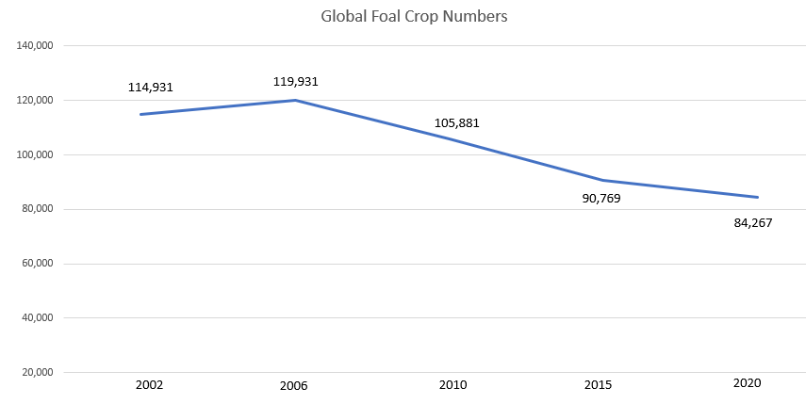
Global Foal Crop Numbers
(data compiled by ISBC)

Slide 17
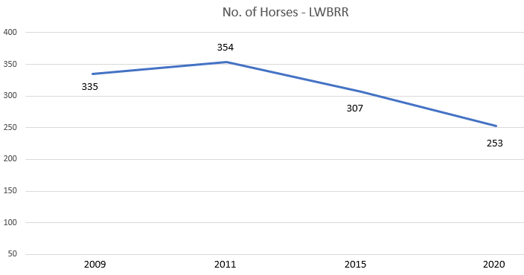
Number of Horses in the Longines World’s Best Racehorse Rankings (115+)

Slide 18
International Quality Control

Slide 19
International Quality Control
Globalisation brings its own challenges and opportunities and nowhere is this more evident than in the area of quality control of Group and Graded races.
The IFHA website describes the fundamental aim of the Federation as “the organisation of competitions to select the best horses in order to improve the quality of the breed”.
Given that one of the fundamental objectives of the IFHA is the selection of the best horses and the improvement of the breed, the system of quality control over these best races is very important.

Slide 20
International Quality Control
The IFHA has encouraged a regional approach to quality control, with IRPAC having issued guidelines to racing authorities to determine where particular races should be placed in the ICS Book.
These guidelines require countries to have a committee to overview the Group and Graded races. It requires that all such races must be open to international competition. It requires each country to have a specific process to assess the quality of their races. It requires that upgrades must be justified by the quality of the runners and it requires that races not meeting the relevant quality should be downgraded.

Slide 21
International Quality Control
An Asian Pattern Committee was established in 2011 to pull together the work of the various grading committees in member countries of the Asian Racing Federation.
Creation of the South American Pattern Committee followed in 2012.
The regional authorities that are recognised by IRPAC for determination of Group or Graded status in Part I of the Blue Book are:
European Pattern Committee
American Graded Stakes Committee and the Canadian Graded Stakes Committee
Asian Pattern Committee
Organizacion LatinoAmericana de Fomenta del Pura Sangre de Carrera (OSAF)

Slide 22
So how is quality control enacted around the world?
Using horses’ ratings is the most common way of identifying the status of Group and Graded races.
Some countries or regions use other criteria to assess quality, such as prize money levels, number of black type performances, quality of all runners in a race - not just the placed horses - accrued performance points, and the overall shape of a country’s Pattern.
Ground Rules for Asia and South America mirror the basic format of the European Pattern Committee’s, albeit the quality control has less rigour.
Disparities in racing standards have precluded the integration of races into a unified world Pattern.

Slide 23
Questions to consider:
Are there anomalies in the system whereby races carry a particular grading in one country or region, but would not merit the same grading in another region?
Should we have one uniform system of grading races worldwide?
Are there too many Group/Graded races across the globe?
What about the issue of medication?
Notes:
Significant progress has been made in the last thirty years in this area, however this simply means there is now much more work to do.

Slide 24
Using the Pattern to influence behaviour

Slide 25
Using the Pattern to Influence Behaviour
Although the Pattern is intended to be of permanent value, it is not set in stone and needs to embrace continuous development, and may even help deliver certain strategic goals.
The Pattern is a living entity and if it is to continue to be fit for purpose, it must of course be adaptable and responsive to changes in horseracing as a whole.
The spirit of competition is a spur to the improvement of racing standards everywhere. For all these reasons the Pattern is under constant stress.

Slide 26
Using the Pattern to influence behaviour – examples from Europe
Enhancing the Black Type programme for Fillies and Mares
Concerted effort made in Europe 15 years ago to improve the Pattern and Listed programme for older fillies and mares.
The Sprint Programme
In 2015, measures were taken to address the lack of any Black Type opportunities for three-year-old sprinters, culminating in the creation of the Group 1 Commonwealth Cup at Royal Ascot.
Safeguarding and Developing the Staying Horse
Much done in recent years to promote staying races in the Pattern programme. Long-term and vital project, with a weighty responsibility to nurture the continued production of quality middle-distance and staying horses.

Slide 27
Safeguarding of the Pattern today
Modus operandi remains as it ever was:
The provision of a co-ordinated programme of quality races across any given region.
Countries working together rather than against each other.
Consistent quality control – at least regionally, albeit potential for greater consistency globally.
Collective responsibility that sees the value of Black type protected for the future.

